Slide 1
Utilizing DESDEO the framework and adding new contents to DESDEO
Juuso Pajasmaa
Multiobjective Optimization Group, University of Jyväskylä
Notes:
Add logos

Slide 2
Contents
Introduction
Installing and using DESDEO
How to create your own MOP using DESDEO?
Adding new contents to DESDEO

Slide 3
Juuso Pajasmaa
I am Juuso Pajasmaa, a Master's Student in the Multiobjective Optimization Group at the University of Jyväskylä.
I have worked on extending DESDEO, little here and there.
Find me on GitHub: jpajasmaa
Notes:
Say better the 2nd sentence

Slide 4
Introduction
We are now familiar with multiobjective optimization and interactive methods, both scalarization based and evolutionary based and some types of preference information.
Some familiarity with the basics of using Python and git is assumed.
However, DESDEO has documentation and various examples.
In addition, questions are welcome!
This talk aims to give some understanding of how to use the DESDEO* framework to solve multiobjective optimization problems (MOPs) using interactive methods and how to extend DESDEO.
*G. Misitano, B. S. Saini, B. Afsar, B. Shavazipour, and K. Miettinen. “DESDEO: The Modular and Open Source Framework for Interactive Multiobjective Optimization”. IEEE Access 9 (2021), pp. 148277–148295. doi: 10.1109/ACCESS.2021.3123825
Notes:
SAY RATHER Give understanding how to use DESDEO and extend DESDEO
User needs to be able to install DESDEO on their machine and then be able to get solve a MOP.
Power user can implement their own MOPs and solve them using DESDEO.
Power user may form their own MOP, maybe implement their own interactive method and visualizations or GUI.

Slide 5
Installing and using DESDEO
How to get started with DESDEO

Slide 6
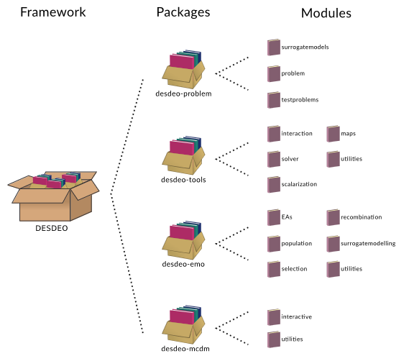
Installing DESDEO
You have a working version of Python 3.9 or newer.
The main DESDEO package can be found on Python Package Index (PyPI) and can be installed with pip:
pip install desdeo
We also have documentation how to do this link.
https://desdeo.readthedocs.io/en/latest/software.html

Slide 7
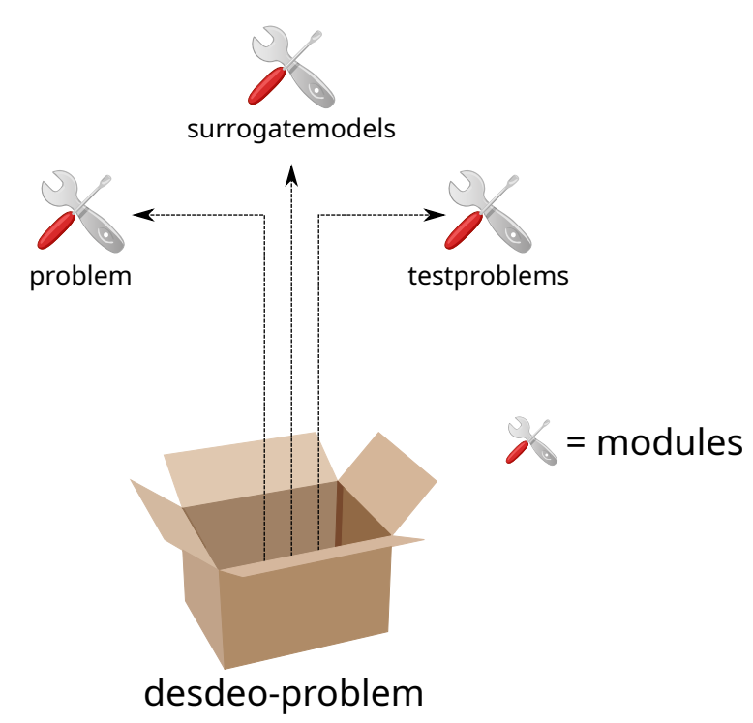
How to use DESDEO
After installing DESDEO successfully, we need to have a MOP to solve, select the interactive method to use and have a DM who provides preference information.
DESDEO uses MOProblem class to represent MOPs.
Later, we discuss MOProblem in more detail.
The desdeo-problem -package contains ready-to-use real-world and benchmark test problems.
To get started let us use a benchmark problem.
Notes:
Lessen text since you are saying so little anyway
002957

Slide 8
Using benchmark problems with DESDEO
First, we need to import the test_problem_builder from desdeo-problem.
Currently supported benchmark problems are ZDT1-4, ZDT6, and DTLZ1-7.
Use the test_problem_builder to generate an MOProblem instance.
Arguments to give:
name of the benchmark problem
for DTLZ problems also the number of objective functions and number of decision variables.
Notes:
fix the colorscheme

Slide 9
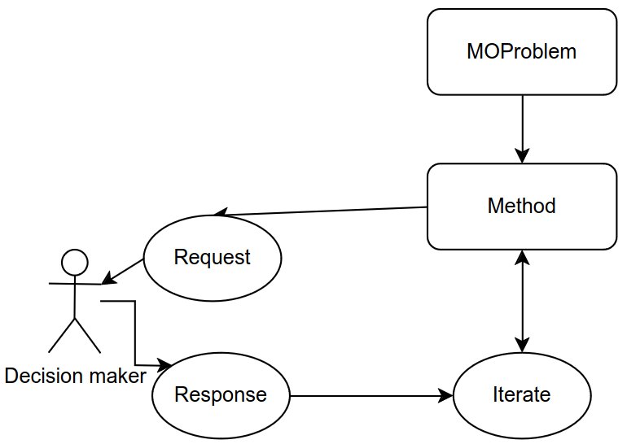
How interactive methods work in DESDEO?
Start
Iterate
They return at least request for preferences Python object.
Request and Response
The response should be a dictionary containing the preference information relevant to the method.
Check the DESDEO paper for more details!
Notes:
The response should be a dictionary containing the preference information relevant to the method.
The methods in desdeo-mcdm generally iterate and stop, when they need new preference information. However, in desdeo-emo in interactive EMOAs, the user must call iterate for every generation, so use loops for example.
Change codes to ignore plot request, we do not need it.
The start method returns two requests of which the second one is irrelevant for this example and has been marked with an underscore.

Slide 10
Providing preferences: request
As an example, let us look at NIMBUS. Note, that the user can specify the solver to use in NIMBUS.
The request object contains a message.

Slide 11
Providing preferences: response
The DM provides the following classification for the objective functions, asks for 3 new solutions and provides the aspiration levels for the objective functions.
Set the response to the preference_request.response
Then, set the preference_request as an argument to the method.iterate

Slide 12
Further examples
DESDEO documentation contains examples of how to use the benchmark problems, and different interactive methods.
For example:
NIMBUS : https://desdeo-mcdm.readthedocs.io/en/latest/notebooks/synchronous_nimbus.html
Solving the River Pollution Problem with interactive RVEA : https://desdeo-emo.readthedocs.io/en/latest/notebooks/River_Pollution.html
Car side impact design problem : https://desdeo-problem.readthedocs.io/en/latest/problems/car_side_impact.html
Using DESDEO tutorial (video) : https://www.youtube.com/watch?v=DC1Dn4DBEwk&t=1538s

Slide 13
How to create your own MOP using DESDEO?
Closer look at the MOProblem class
Notes:
Quality and get rid of the arrow

Slide 14
MOProblem
The MOProblem class is included in the desdeo-problem -package.
MOProblem is built form the following blocks:
Variables
Objectives
Constraints
Imports used in this part:

Slide 15
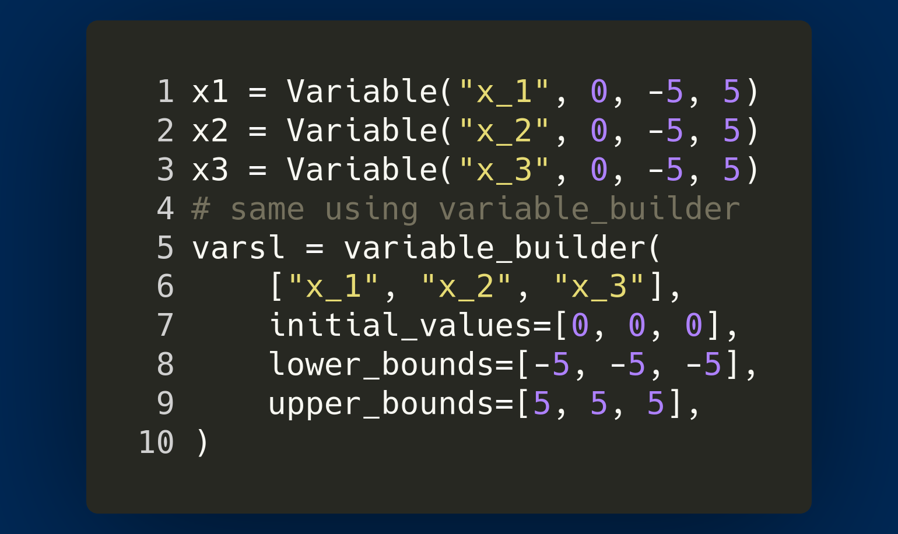
Variables
Variable class takes as arguments the name of the variable, starting value, lower and upper bounds.
Starting value must be within the bounds.
The names of the variables should be meaningful to the DM.
Currently, DESDEO supports only continuous decision variables, however the minimum viable product of DESDEO will have mixed-integer variables.
You can define each Variable one by one or use the variable_builder class. The variable_builder class the arguments as lists.
Notes:
shorten

Slide 16
Objectives
The required arguments:
names of the objective functions and
an evaluator, which is a Python Callable that takes in the decision variables as its input and returns the corresponding objective function values.
Other arguments:
lower and upper bounds for the objective functions.
Whether the objective function is to be maximized (default is to minimize).
DESDEO has two types of objective function classes ScalarObjective and
VectorObjective.
Use ScalarObjective when the evaluator evaluates only one objective.
Use VectorObjective when the evaluator evaluates and returns more than one objective at once.
Notes:
Consider dropping making two slides of them, since they are so similar, just show the code of scalarObj and mention what to do if more

Slide 17
Example of using the ScalarObjective class
Notes:
Fix pics
Mention of the np. 2d array because there is one solution per row etc

Slide 18
Constraints
DESDEO uses ScalarConstraint class.
Constraint may depend on the decision variable values as well as the (objective functions).
The constraint should be defined to return a positive value if it is met and a negative value if it is not met.
The arguments:
name of the constraint, number of variables, number of objectives and a Python Callable.
For example, we have the following constraint for the variables:
Notes:
Give example how to formulate the constraint, eg. Simple math notation fucntion and then (or with math too) in code how it is transformed.
Remove the y, usually not needed.

Slide 19
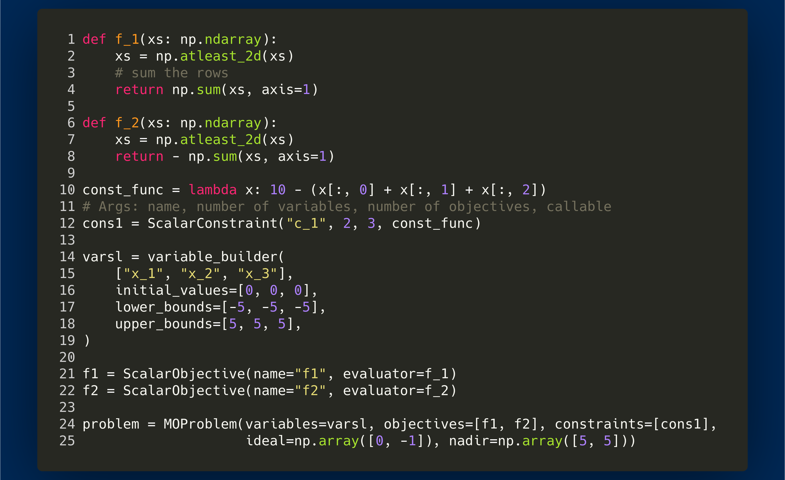
Forming a MOProblem
Form the MOP by using desdeo_problem.Problem.MOProblem class.
MOProblem takes as lists the arguments
Variables,
Objectives,
Constraints
You can also provide the ideal and nadir vectors.
MOProblem contains:
evaluate method evaluates all the objective and constraint values for given set of decision variables using the evaluators in objective functions and constraints.
Notes:
Add that constraints needs list in code

Slide 20
The output of MOProblem
Use the MOProblem.evaluate method.
The objective values are in evaluation_result.objectives.
The evaluation_result contains also other information.
One objective vector per row.
Notes:
All of these can be accessed separately e.g. by calling the result object.objectives to get objective values
Is fitness values fixed already and which way we decided?

Slide 21
Forming a DataProblem
DataProblem class takes as arguments:
the data as pandas DataFrame
objective names
variable names
DataFrame containing which objective functions are maximized or minimized.
You can also read data from example .csv files
Further example: https://desdeo-problem.readthedocs.io/en/latest/notebooks/Defining_a_data_based_problem.html
Notes:
In DataProblems, some methods find the most preferred solution from a provided dataset such as E-NAUTILUS and some methods as many of the methods in desdeo-emo require a surrogate model to be trained for each of the objectives.
Both cases are supported.
The surrogate modeling technique (here gaussianprocessregressor based on sklearn) and the model parameters need to be passed to the DataProblems train method.

Slide 22
Adding new contents to DESDEO
The workflow to extend DESDEO
Notes:
Here, we learn how to extend DESDEO.
Just adding a MOP, however, steps work to methods tools etc. Easier to show in our time limit compared to new algorithm etc.

Slide 23
Git workflow
DESDEO contributing guidelines
Contributing to DESDEO video tutorial
Git workflow tutorial
Notes:
Explain the workflow

Slide 24
Installing DESDEO for developers
Poetry is a tool for dependency management and packaging in Python.
1. Fork the desdeo-problem repository.
2. Clone the repository
Change directories
3. Create a new branch in your local package
(optional but suggested) Create a new virtual environment for the project. Poetry tip: for selecting specific python version (python3.9 must be on your $PATH)
Init poetry
Run poetry install inside the virtual environment shell.
Notes:
Fix locations

Slide 25
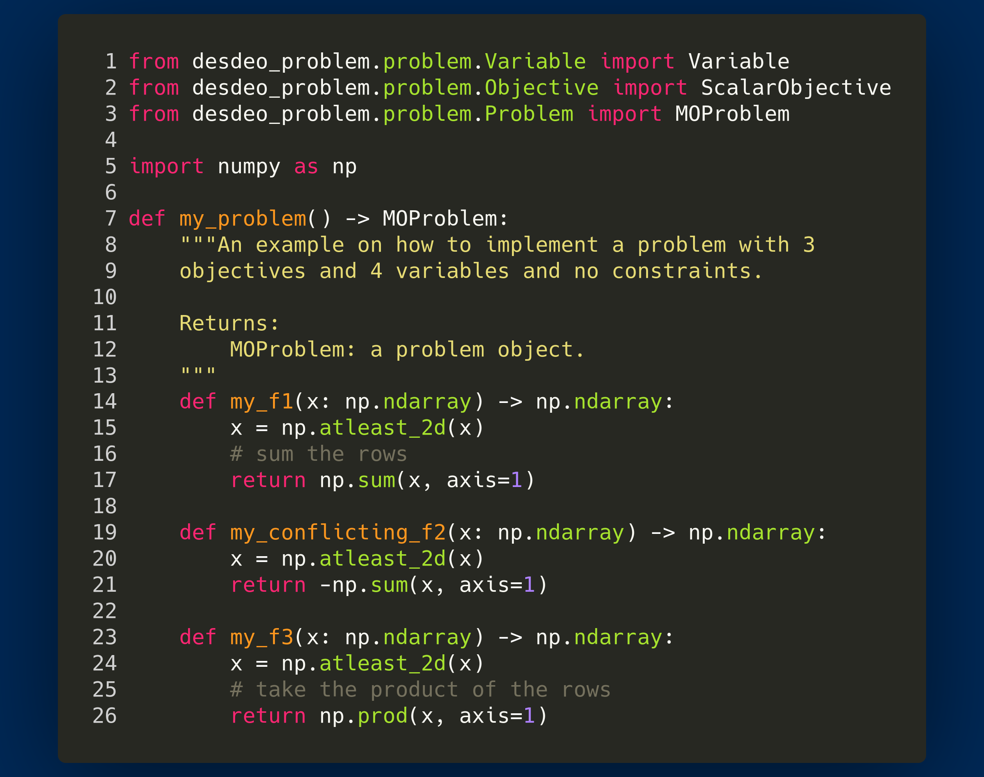
4. Code: My new MOProblem
Notes:
Explain with more words, no need to rush even though everything is told earlier

Slide 26
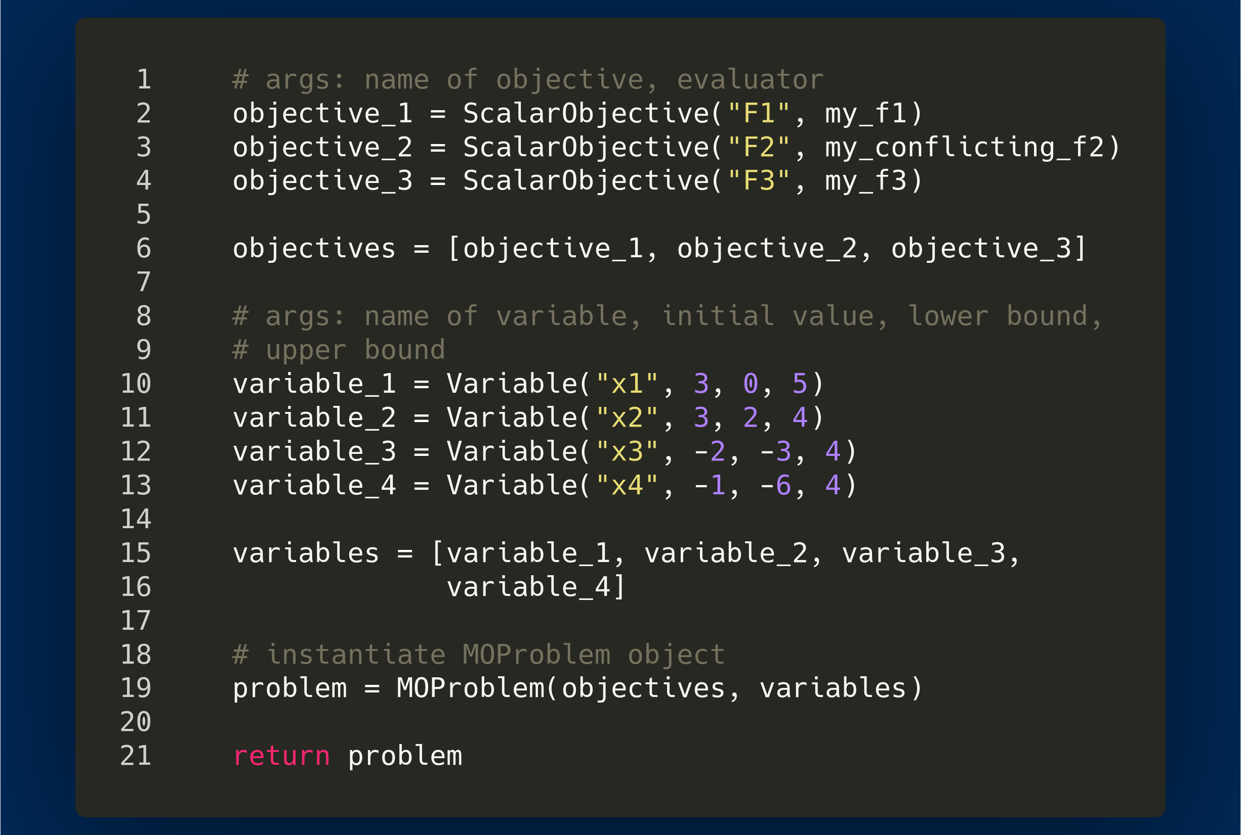
4. Code: My new MOProblem

Slide 28
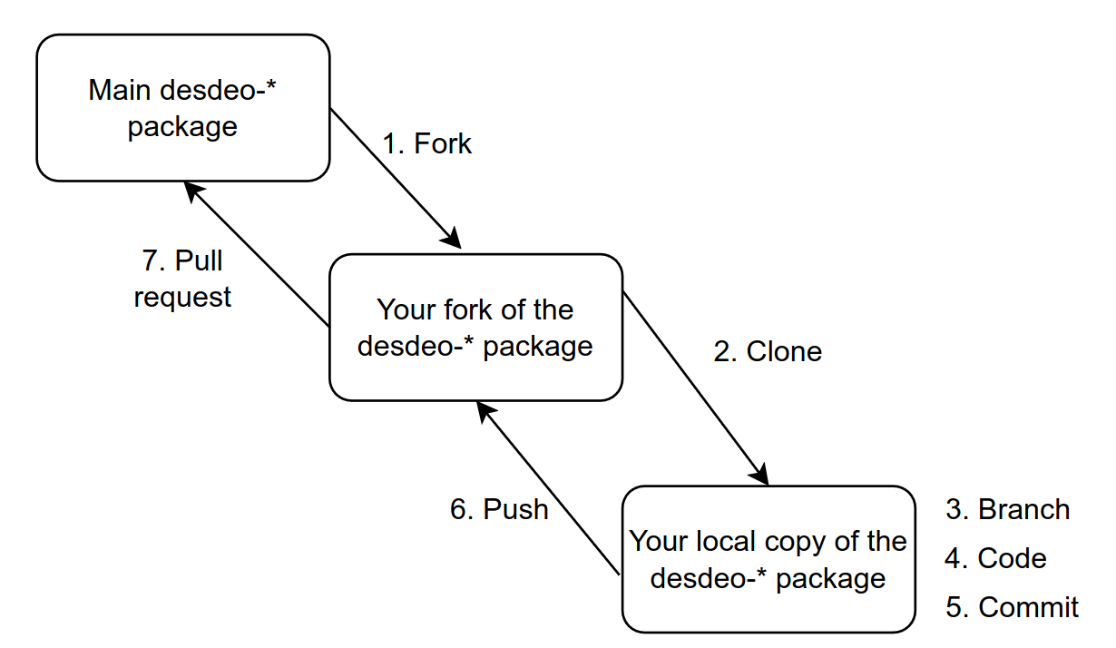
Let others benefit from your work!
5. Commit
6. Push
7. Pull request
After your Pull request has been accepted, everyone can benefit from your work!
Notes:
Think more what you want to say, since you used the picture already..
FIx this

Slide 29
Additional information
Utilize the existing code.
Keep modularity in mind, while creating methods.
TESTING, make unit tests.
Documentation is for you and for other people.
We also welcome smaller contributions! From small typing error fixes to bigger issues!
No need to start with implementing the most complex method, anything helps!
If you notice an issue, please, let us know by making a new issue in GitHub.
Cite the DESDEO Paper !
For more details, check the Contribution guidelines!
Notes:
(and any other you in the future)
Fix wordings if issues

Slide 30
Summary
We discussed
How to use benchmark problems and combine them with interactive methods in DESDEO.
How to build your own MOP using the MOProblem or DataProblem classes from desdeo-problem.
The basics of how interactive methods work in DESDEO under the hood.
An example workflow of working with DESDEO and contributing to DESDEO.
Notes:
Rephrasing
. rephrasing not to promise too much

