Slide 1
Latest advancement on multiobjective robust decision-making under deep uncertainty: An interactive framework
Babooshka Shavazipour *, Jan Kwakkel**, Kaisa Miettinen*
*Multiobjective Optimization Group, Faculty of Information Technology, University of Jyväskylä, Jyväskylä, Finland
**Faculty of Technology, Policy and Management, Delft University of Technology, Delft, The Netherlands

Slide 2
The proposed two-phase interactive framework
MORDM
1a. Decision problem definition
Decision variables, objectives, constraints,
uncertain factors, robustness measures
1. Model Specification
objectives, constraints,
uncertainties, robustness, etc.
Phase 1:
Scoping the model
1b. Scenario analysis
Scenario generation,
Feasible regions & ideal values
Vulnerable scenarios
2. Solution identification
Using a multi-objective
(evolutionary) method with
a reference scenario (at a time)
2a. Preferences expression
Scenarios to be considered (optional)
Desired objective values in selected scenarios
Max num. of solutions to be compared (optional)
3. Robustness analysis
(Re-)evaluation over a
wide variaty of scenarios
Phase 2:
Interactive robust decision-making
2b. Solution identification
Solve a multi-scenario multi-objective
optimization problem
4. Scenario Discovery
2c. Tradeoffs analysis & decision-making
Identify vulnerable scenrios
Comparing solutions & tradeoffs/robustness analysis
Kasprzyk et al. (2013)*
* MORDM: Kasprzyk JR, Nataraj S, Reed PM & Lempert RJ (2013), ‘Many objective robust decision making for complex environmental systems undergoing change’, Env. Mod. & Soft. 42, 55–71.
RDM: $Lempert et al. (2006), ‘A general, analytic method for generating robust strategies and narrative scenarios’,Management Science 52(4), 514–528.$
B. Shavazipour, J. Kwakkel and K. Miettinen
Notes:
Solving the multi-scnario multi-objective optimization problem interactively to generate candidate solutions incorporating decision-makers preferences.
Vulnerable scenarios, if Jan did not define it

Slide 3
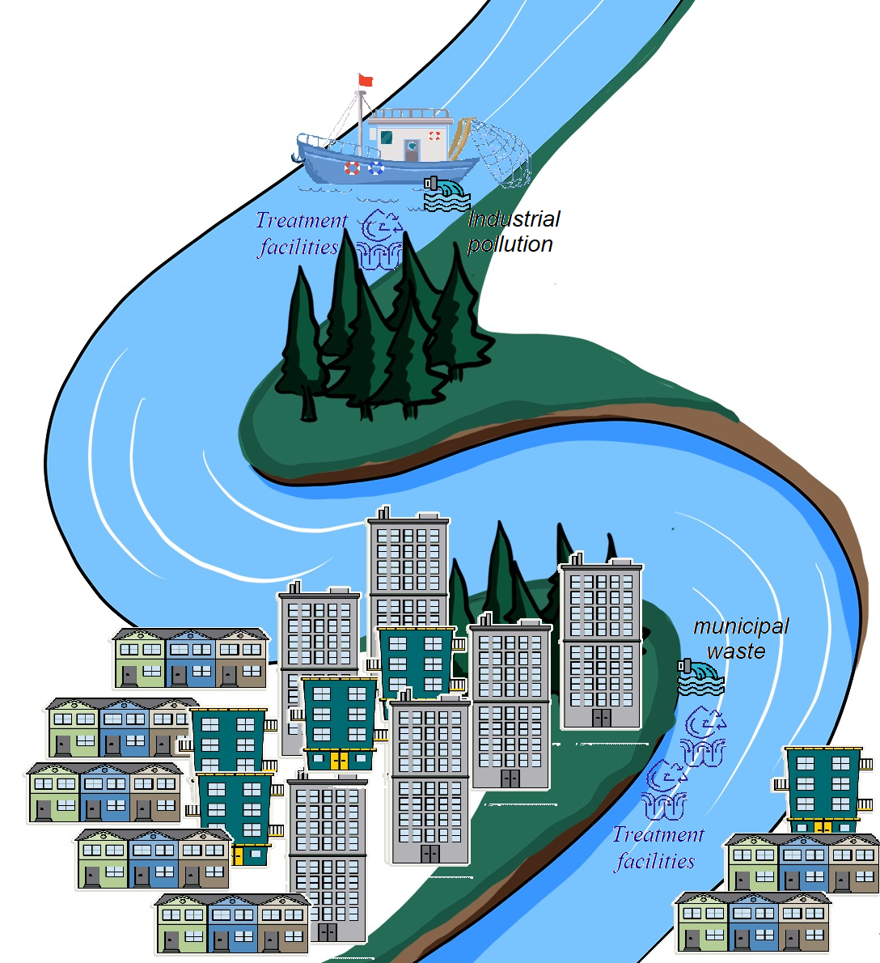
Case study - water quality management* (an extended uncertain version)
Extra treatment facilities are required to reduce the pollution of the city and the Fresh Fishery
The costs would decline Fresh Fishery’s investment return and raise the city’s tax rate.
Two decisions to be made are the proportional amounts of pollution to be removed from water discharge at the Fresh Fishery ($x_{1}$) and at the city ($x_{2}$).
* Narula, S. C. & Weistroffer, H. R. (1989), ‘A Flexible Method for Nonlinear Multicriteria Decision-Making Problems’, IEEE Transactions on Systems, Man and Cybernetics 19(4), 883–887.
B. Shavazipour, J. Kwakkel and K. Miettinen
Notes:
With this example we can illustrate more details about how the proposed method can be applied
two sources of pollution (milligrams of biochemical oxygen demanding material (BOD)):
-municipal waste produced by the city and
-industrial pollution caused by a Fresh Fishery
The decisions to be made here is that
How much pollution we should remove

Slide 4
1. Scoping the model
1a. Decision problem formulation - Water quality management (extended version)
Max Water quality at the Fresh Fishery ($f_{1}(x)$) = $α+\left(\log\left({\left(\frac{β}{2}−1.14\right)}^{2}\right)+ β^{3}\right)x_{1}$
Max Water quality at the city ($f_{2}(x)$) = $γ+ δx_{1}+ξx_{2}+\frac{0.01}{η−x_{1}^{2}}+\frac{0.3}{η−x_{2}^{2}}$
Max Investment return ($f_{3}(x)$) = $r−\frac{0.71}{1.09−x_{1}^{2}}$
Min Rise in the city’s tax rate ($f_{4}(x)$) =$−0.96+\frac{0.71}{1.09−x_{1}^{2}}$
s.t. $0.3 ≤ x_{1}, x_{2}≤1,$
where $γ=$ $\log\left(\frac{α}{2}−1\right)+ \frac{α}{2}+1.5$.
(Deterministic version)
B. Shavazipour, J. Kwakkel and K. Miettinen
Notes:
only a range of plausible values is known
Say sth about baseline scenario

Slide 5
1. Scoping the model
1a. Decision problem formulation
Robustness measure: Domain criterion* for each objective function.
The decision-maker sets the following criteria for robustness and vulnerability analyses:
$f_{1}$: Water quality at the Fresh Fishery > 4 (mg/L of dissolved oxygen [DO]),
$f_{2}$: Water quality at the city > 4 (mg/L of DO),
$f_{3}$ : Investment return > 4 %,
$f_{4}$: Rise in the city’s tax rate < 0.1 %,
* Starr, M. K. (1963), Product Design and Decision Theory, Fundamentals of engineering design, Prentice-Hall.
B. Shavazipour, J. Kwakkel and K. Miettinen

Slide 6
1. Scoping the model
1b. Scenario analysis
Scenario generation: we generated 10 000 random scenarios (using Latin Hypercube Sampling)
Calculating the ideal (best possible) objective values: solving 30 000 +1 single-scenario single-objective optimization problems (the 4th objective has no uncertain parameter)
Objectives | $$f_{1} \text{(}\text{max}\text{)}$$ | $$f_{2} \text{(}\text{max}\text{)}$$ | $$f_{3} \text{(}\text{max}\text{)}$$ | $$f_{4} \text{(}\text{m}\text{in}\text{)}$$
$$Domain Criterion$$ | > 4 | > 4 | > 4 | < 0.1
 | Objective functions
 | $$f_{1}$$ | $$f_{2}$$ | $$f_{3}$$ | $$f_{4}$$
Best ideal values | 7.224 | 5.440 | 11.790 | 0.00
Worst ideal values | -0.998 | 3.854 | 4.390 | 0.00
B. Shavazipour, J. Kwakkel and K. Miettinen
Notes:
Best and worst-case scenarios

Slide 7
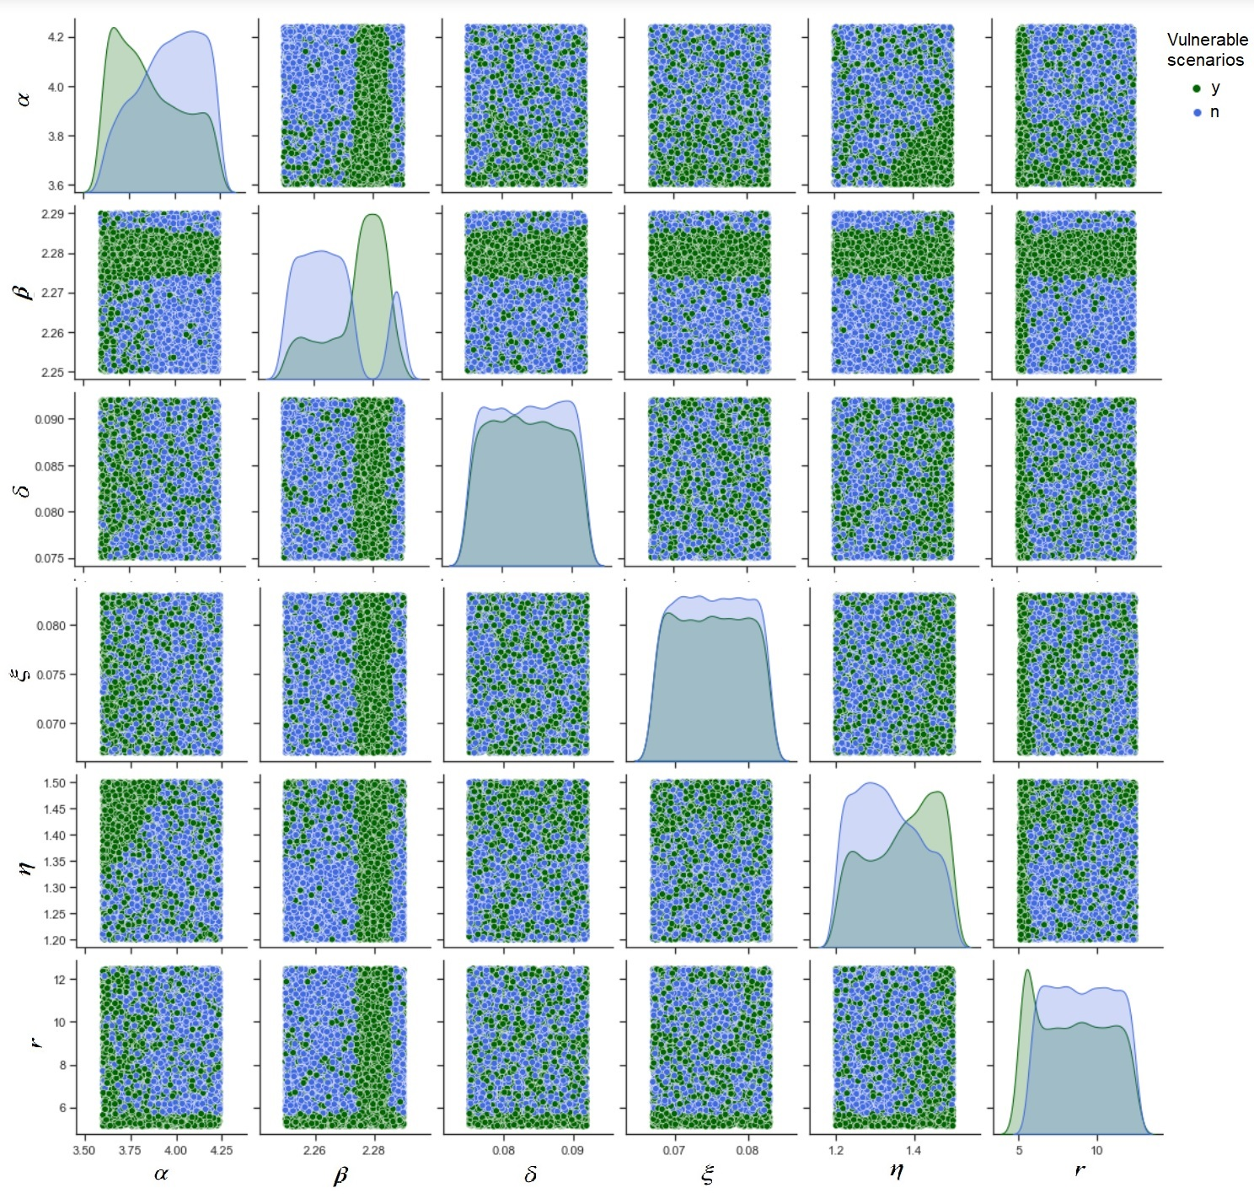
1. Scoping the model
1b. Scenario analysis
iii) Identifying the vulnerabilities (scenarios with poor performances, i.e., the objective values do not meet the domain criteria)
B. Shavazipour, J. Kwakkel and K. Miettinen

Slide 8
2. Interactive robust decision-making phase
Iteration 1
2a. Decision-makers’ preferences
i) Scenarios to be considered (optional)
The baseline scenario (s1) + five more randomly selected scenarios--at least one vulnerable scenario that does not satisfy the domain criterion set for the first objective function (i.e., 2.273 < $β$< 2.286).
Scenarios | Combination of deeply uncertain parameters
 | $$α$$ | $$β$$ | $$δ$$ | $$ξ$$ | $$η$$ | $$r$$
$$s_{1}$$ | 4.070 | 2.270 | 0.0800 | 0.0750 | 1.39 | 8.21
$$s_{2}$$ | 3.868 | 2.262 | 0.0869 | 0.0782 | 1.47 | 10.28
$$s_{3}$$ | 3.620 | 2.278 | 0.0835 | 0.0750 | 1.23 | 5.84
$$s_{4}$$ | 3.372 | 2.254 | 0.0903 | 0.0814 | 1.35 | 11.76
$$s_{5}$$ | 3.124 | 2.270 | 0.0801 | 0.0686 | 1.29 | 7.32
$$s_{6}$$ | 4.116 | 2.286 | 0.0767 | 0.0718 | 1.41 | 8.80
B. Shavazipour, J. Kwakkel and K. Miettinen

Slide 9
2. Interactive robust decision-making phase
Iteration 1
2a. Decision-maker’s preferences
ii) Desired objective values in selected scenarios
Objectives | $$f_{1} \text{(}\text{max}\text{)}$$ | $$f_{2} \text{(}\text{max}\text{)}$$ | $$f_{3} \text{(}\text{max}\text{)}$$ | $$f_{4} \text{(}\text{m}\text{in}\text{)}$$
$$Domain Criterion$$ | > 4 | > 4 | > 4 | < 0.1
Scenarios | Ideal values
 | $$f_{1} \text{(}\text{max}\text{)}$$ | $$f_{2} \text{(}\text{max}\text{)}$$ | $$f_{3} \text{(}\text{max}\text{)}$$ | $$f_{4} \text{(}\text{m}\text{in}\text{)}$$
$$s_{1}$$ | 5.17 | 4.52 | 7.50 | 0
$$s_{2}$$ | 6.02 | 4.19 | 9.57 | 0
$$s_{3}$$ | 3.02 | 4.61 | 5.13 | 0
$$s_{4}$$ | 6.14 | 3.87 | 11.05 | 0
$$s_{5}$$ | 4.22 | 3.70 | 6.61 | 0
$$s_{6}$$ | 4.44 | 4.52 | 8.09 | 0
Scenarios | Preferences on desired values
 | $$f_{1} \text{(}\text{max}\text{)}$$ | $$f_{2} \text{(}\text{max}\text{)}$$ | $$f_{3} \text{(}\text{max}\text{)}$$ | $$f_{4} \text{(}\text{m}\text{in}\text{)}$$
$$s_{1}$$ | 5 | 4.5 | 7 | 0.00001
$$s_{2}$$ | 5 | 4.5 | 5.5 | 0.00001
$$s_{3}$$ | 10 | 4.5 | 4 | 10
$$s_{4}$$ | 5 | 8 | 6 | 0.1
$$s_{5}$$ | 5 | 8 | 6 | 0.1
$$s_{6}$$ | 4.5 | 4.5 | 9 | 0.1
iii) Maximum number of solutions to be compared at each iteration (optional) = 4
B. Shavazipour, J. Kwakkel and K. Miettinen

Slide 10
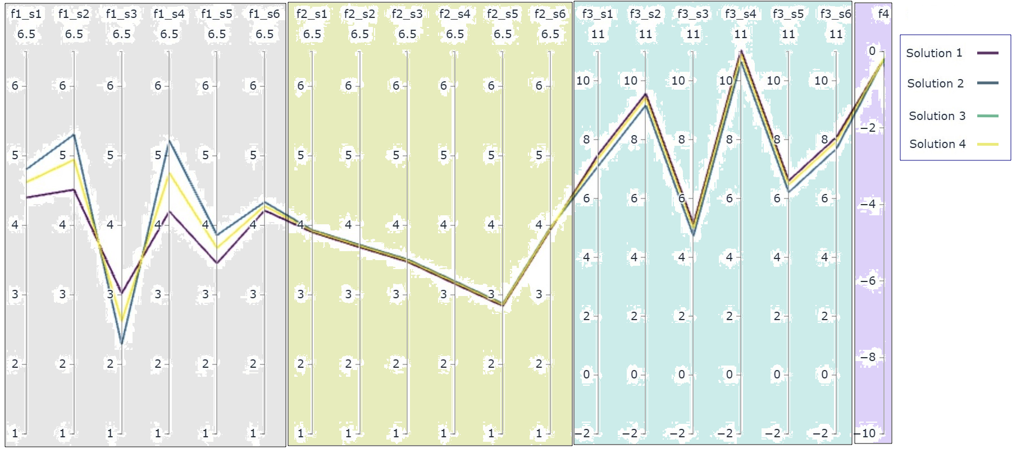
2. Interactive robust decision-making phase
Iteration 1
2b. Solution identification
The analyst solved the corresponding optimization problem with four objectives and six scenarios and generated four solutions
B. Shavazipour, J. Kwakkel and K. Miettinen
Notes:
to unify the improvement direction of the objective functions (upwards (↑)), we inverted the last second column from the right (f4) in the plot.
Highlight each objective

Slide 11
2. Interactive robust decision-making phase
Iteration 1
2c. Trade-off analysis and decision-making
Study the tradeoffs & add solutions to the wish list
Step 0
2b. New solutions
Wish list
Iteration 1
Solution 1
Solution 2
Robustness?
no
Step 1
2a. New preferences
yes
Robustness analysis of the selected solutions
Step 2
Satisfied with a solution?
Step 3
no
yes
Stop
B. Shavazipour, J. Kwakkel and K. Miettinen
Notes:
Wish list to be clarified
Modify arrows

Slide 12
2. Interactive robust decision-making phase
Iteration 2
2a. Decision-maker’s preferences
Objectives | $$f_{1} \text{(}\text{max}\text{)}$$ | $$f_{2} \text{(}\text{max}\text{)}$$ | $$f_{3} \text{(}\text{max}\text{)}$$ | $$f_{4} \text{(}\text{m}\text{in}\text{)}$$
$$Domain Criterion$$ | > 4 | > 4 | > 4 | < 0.1
i) The same 6 scenarios
ii) Desired objective values in selected scenarios
Scenarios | Ideal values
 | $$f_{1} \text{(}\text{max}\text{)}$$ | $$f_{2} \text{(}\text{max}\text{)}$$ | $$f_{3} \text{(}\text{max}\text{)}$$ | $$f_{4} \text{(}\text{m}\text{in}\text{)}$$
$$s_{1}$$ | 5.17 | 4.52 | 7.50 | 0
$$s_{2}$$ | 6.02 | 4.19 | 9.57 | 0
$$s_{3}$$ | 3.02 | 4.61 | 5.13 | 0
$$s_{4}$$ | 6.14 | 3.87 | 11.05 | 0
$$s_{5}$$ | 4.22 | 3.70 | 6.61 | 0
$$s_{6}$$ | 4.44 | 4.52 | 8.09 | 0
Scenarios | Preferences on desired values
 | $$f_{1} \text{(}\text{max}\text{)}$$ | $$f_{2} \text{(}\text{max}\text{)}$$ | $$f_{3} \text{(}\text{max}\text{)}$$ | $$f_{4} \text{(}\text{m}\text{in}\text{)}$$
$$s_{1}$$ | 4 | 15 | 4 | 0.00001
$$s_{2}$$ | 4 | 15 | 4 | 0.00001
$$s_{3}$$ | 10 | 15 | 4 | 0.00001
$$s_{4}$$ | 4 | 15 | 4 | 0.00001
$$s_{5}$$ | 4 | 15 | 4 | 0.00001
$$s_{6}$$ | 4 | 15 | 4 | 0.00001
Scenarios | Preferences (previous iteration)
 | $$f_{1} \text{(}\text{max}\text{)}$$ | $$f_{2} \text{(}\text{max}\text{)}$$ | $$f_{3} \text{(}\text{max}\text{)}$$ | $$f_{4} \text{(}\text{m}\text{in}\text{)}$$
$$s_{1}$$ | 5 | 4.5 | 7 | 0.00001
$$s_{2}$$ | 5 | 4.5 | 5.5 | 0.00001
$$s_{3}$$ | 10 | 4.5 | 4 | 10
$$s_{4}$$ | 5 | 8 | 6 | 0.1
$$s_{5}$$ | 5 | 8 | 6 | 0.1
$$s_{6}$$ | 4.5 | 4.5 | 9 | 0.1
iii) Maximum number of solutions to be compared at each iteration (optional) = 4
B. Shavazipour, J. Kwakkel and K. Miettinen
Notes:
-they raised the aspiration levels for the second objective in all scenarios while sacrificing their desires for other objectives in various scenarios to see how these may affect the newly identified solutions.

Slide 13
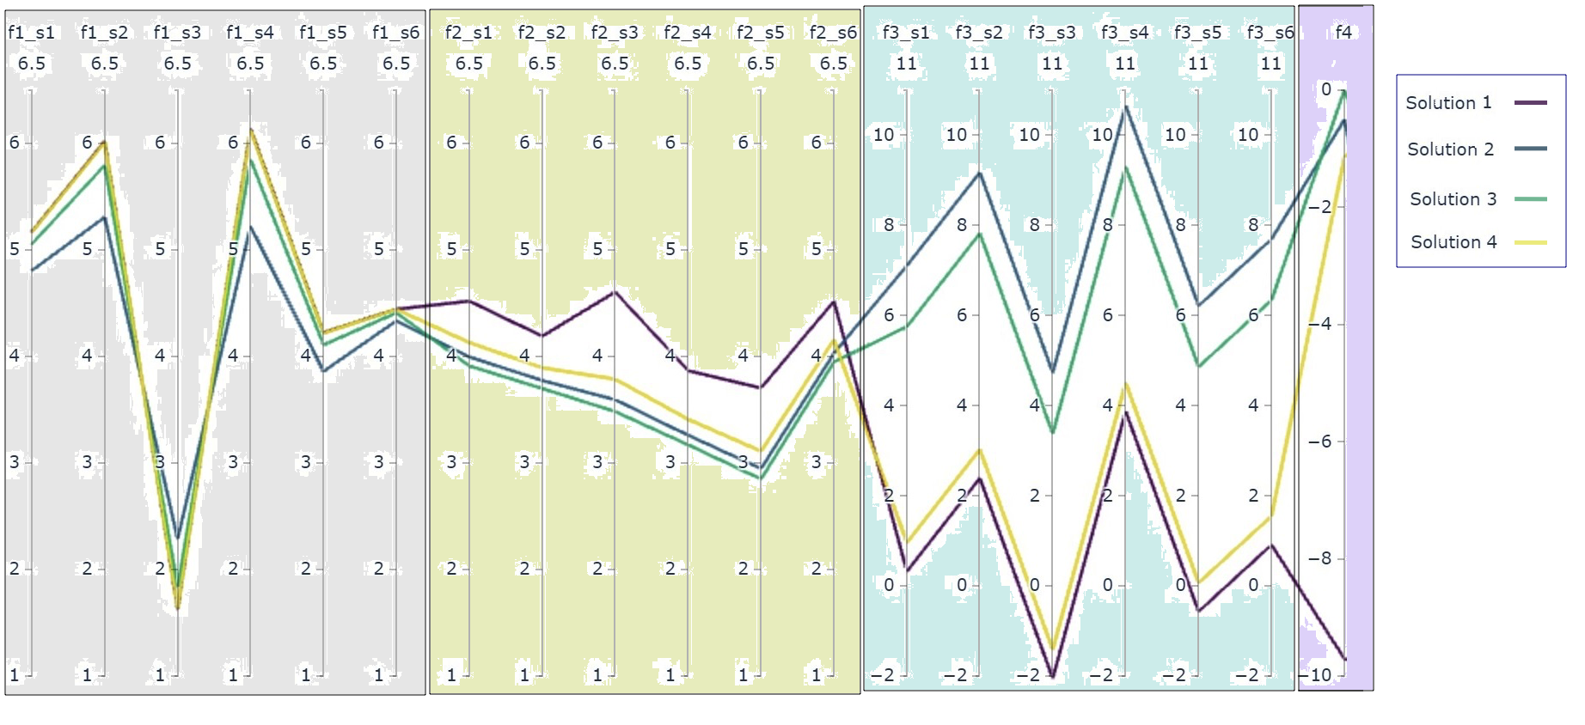
2. Interactive robust decision-making phase
Iteration 2
2b. Solution identification
The analyst solved the corresponding sixth-scenario fourth-objective optimization problem and generated four solutions
B. Shavazipour, J. Kwakkel and K. Miettinen
Notes:
- to unify the improvement direction of the objective functions (upwards (↑)), we inverted the last second column from the right (f4) in the plot.

Slide 14
2. Interactive robust decision-making phase
Iteration 2
2c. Trade-off analysis and decision-making
Study the tradeoffs & add solutions to the wish list
Step 0
2b. New solutions
Wish list
Iteration 1
Solution 1
Solution 2
Robustness?
no
Step 1
2a. New preferences
1
2
3
4
5
yes
Iteration 2
Solution 1
Solution 3
Solution 4
Robustness analysis of the selected solutions
Step 2
Satisfied with a solution?
Step 3
no
yes
Stop
B. Shavazipour, J. Kwakkel and K. Miettinen
Notes:
- to unify the improvement direction of the objective functions (upwards (↑)), we inverted the last second column from the right (f4) in the plot.

Slide 15
2. Interactive robust decision-making phase
Iteration 3
2a. Decision-maker’s preferences
Objectives | $$f_{1} \text{(}\text{max}\text{)}$$ | $$f_{2} \text{(}\text{max}\text{)}$$ | $$f_{3} \text{(}\text{max}\text{)}$$ | $$f_{4} \text{(}\text{m}\text{in}\text{)}$$
$$Domain Criterion$$ | > 4 | > 4 | > 4 | < 0.1
i) The same 6 scenarios
ii) Desired objective values in selected scenarios
Scenarios | Ideal values
 | $$f_{1} \text{(}\text{max}\text{)}$$ | $$f_{2} \text{(}\text{max}\text{)}$$ | $$f_{3} \text{(}\text{max}\text{)}$$ | $$f_{4} \text{(}\text{m}\text{in}\text{)}$$
$$s_{1}$$ | 5.17 | 4.52 | 7.50 | 0
$$s_{2}$$ | 6.02 | 4.19 | 9.57 | 0
$$s_{3}$$ | 3.02 | 4.61 | 5.13 | 0
$$s_{4}$$ | 6.14 | 3.87 | 11.05 | 0
$$s_{5}$$ | 4.22 | 3.70 | 6.61 | 0
$$s_{6}$$ | 4.44 | 4.52 | 8.09 | 0
Scenarios | Preferences on desired values
 | $$f_{1} \text{(}\text{max}\text{)}$$ | $$f_{2} \text{(}\text{max}\text{)}$$ | $$f_{3} \text{(}\text{max}\text{)}$$ | $$f_{4} \text{(}\text{m}\text{in}\text{)}$$
$$s_{1}$$ | 5 | 5.4 | 7 | 5
$$s_{2}$$ | 5.5 | 6.4 | 9 | 5
$$s_{3}$$ | 3.1 | 6.4 | 4.5 | 5
$$s_{4}$$ | 5.5 | 6 | 10 | 5
$$s_{5}$$ | 4 | 6 | 5 | 5
$$s_{6}$$ | 4.4 | 6.4 | 7 | 5
iii) Maximum number of solutions to be compared at each iteration (optional) = 4
B. Shavazipour, J. Kwakkel and K. Miettinen
Notes:
-the existing trade-offs between the objectives (particularly the second objective against the third and the fourth ones),
-reduce aspiration levels in the fourth objective and relax it a bit in all scenarios.
they set aspiration levels for the first and the third objectives close to the ideal values in each scenario. Still, they wished to emphasize on achievements of the second objective by setting their desired values 30 − 50% above the ideal values in different scenarios
Finally, they set aspiration levels between the ideal and nadir values for the fourth objective to get more
balanced solutions.

Slide 16
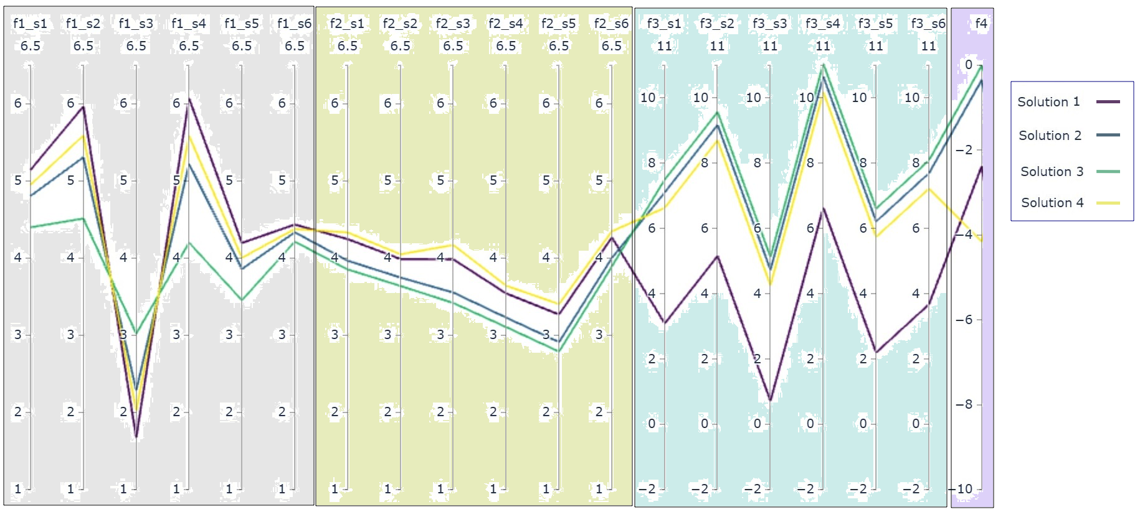
2. Interactive robust decision-making phase
Iteration 3
2b. Solution identification
The analyst solved the corresponding sixth-scenario fourth-objective optimization problem and generated four solutions
B. Shavazipour, J. Kwakkel and K. Miettinen
Notes:
to unify the improvement direction of the objective functions (upwards (↑)), we inverted the last second column from the right (f4) in the plot.

Slide 17
2. Interactive robust decision-making phase
Iteration 3
2c. Trade-off analysis and decision-making
Study the tradeoffs & add solutions to the wish list
Step 0
2b. New solutions
Wish list
Iteration 1
Solution 1
Solution 2
Robustness?
no
Step 1
2a. New preferences
1
2
3
4
5
6
7
yes
Iteration 2
Solution 1
Solution 3
Solution 4
Robustness analysis of the selected solutions
Step 2
Iteration 3
Solution 1
Solution 4
Satisfied with a solution?
Step 3
no
yes
Stop
B. Shavazipour, J. Kwakkel and K. Miettinen
Notes:
- to unify the improvement direction of the objective functions (upwards (↑)), we inverted the last second column from the right (f4) in the plot.

Slide 18
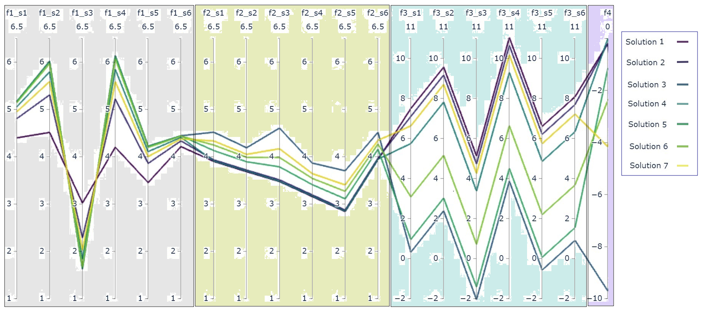
2. Interactive robust decision-making phase
Iteration 3
2c. Trade-off analysis and decision-making
Comparing seven candidate solutions selected in three iterations
B. Shavazipour, J. Kwakkel and K. Miettinen
Notes:
- to unify the improvement direction of the objective functions (upwards (↑)), we inverted the last second column from the right (f4) in the plot.

Slide 19
2. Interactive robust decision-making phase
Iteration 3
2c. Trade-off analysis and decision-making
Study the tradeoffs & add solutions to the wish list
Step 0
2b. New solutions
Wish list
Iteration 1
Solution 1
Solution 2
Robustness?
no
Step 1
2a. New preferences
1
2
3
4
5
6
7
yes
Iteration 2
Solution 1
Solution 3
Solution 4
Robustness analysis of the selected solutions
Step 2
Iteration 3
Solution 1
Solution 4
Satisfied with a solution?
Step 3
no
yes
Stop
B. Shavazipour, J. Kwakkel and K. Miettinen
Notes:
- to unify the improvement direction of the objective functions (upwards (↑)), we inverted the last second column from the right (f4) in the plot.

Slide 20
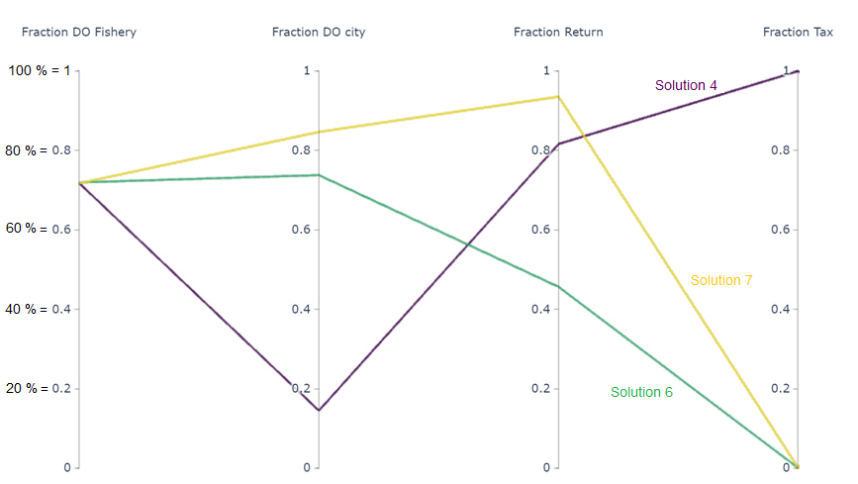
2. Interactive robust decision-making phase
Iteration 3
2c. Trade-off analysis and decision-making
To robustness analysis, for each objective function, the analyst re-evaluated each solution over the 10 000 randomly generated scenarios and counted the number of scenarios meeting the domain criterion in each solution.
$${(f}_{1} robustness)$$
$${(f}_{2} robustness)$$
$${(f}_{3}robustness)$$
$${(f}_{4}robustness)$$
Fig. The robustness trade-offs of the selected solutions (number of scenarios satisfying the domain criterion for each objective).
B. Shavazipour, J. Kwakkel and K. Miettinen
Notes:
to unify the improvement direction
Change fraction in the figure n of the objective functions (upwards (↑)), we inverted the last second column from the right (f4) in the plot.
Explain more about re-evaluation for robustness

Slide 21
Conclusions
We propose an interactive framework involving decision-makers during the solution process to gain insight into the problem and can influence the solution process when they provide their preferences.
However, there is a need for experimental studies in different real-life problems to see how it would be successful.
Single decision-maker vs Group of decision-makers
B. Shavazipour, J. Kwakkel and K. Miettinen
JYU. Since 1863.
21
Notes:
Improves the quality of solutions; i.e. more balanced solutions
Also Decrease the computational cost (several hours vs. several days)

Slide 22
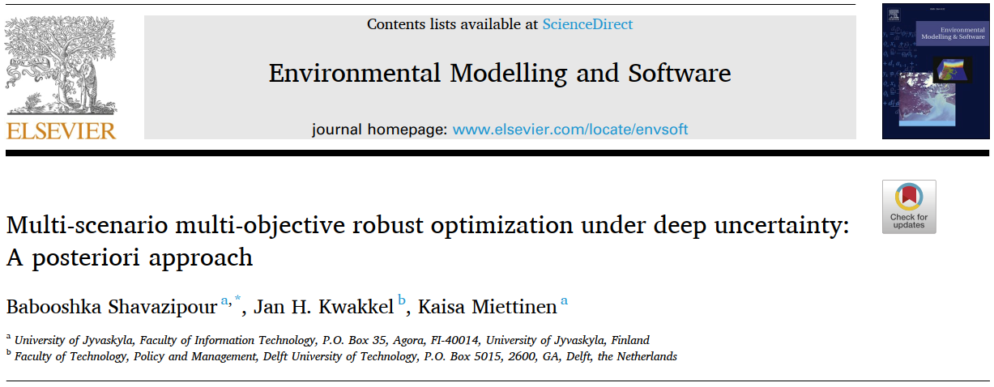
https://desdeo.it.jyu.fi
Funded by the Academy of Finland (grant no 322221)
The world is deeply uncertain & multi-objective

